Slide 1
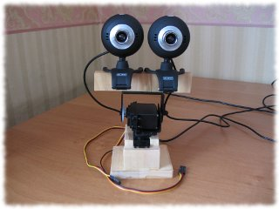
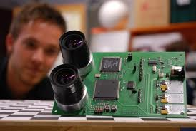
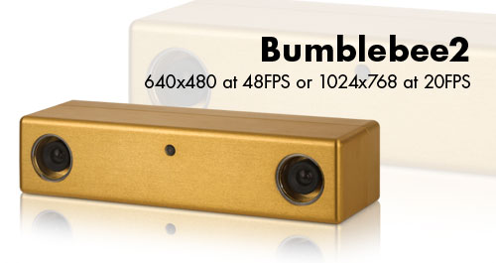
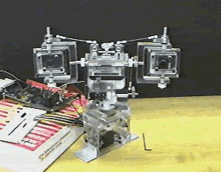
STEREO CAMERAS AND STEREO HEADS

Slide 2
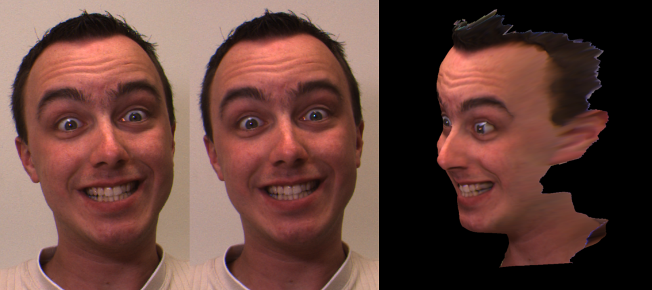
(SILLY) FACE RECONSTRUCTION

Slide 3
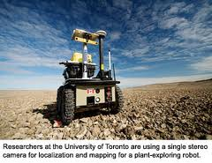
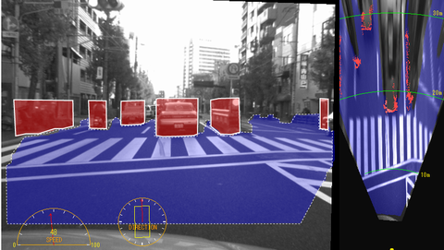
ROBOT AND CAR NAVIGATION

Slide 4
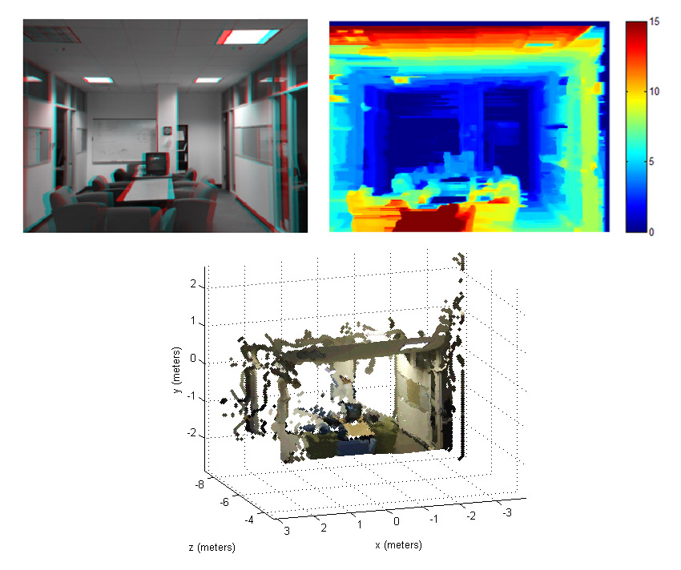
ROBOT NAVIGATION - ODOMETRY AND SURFACE RECONSTRUCTION

Slide 5
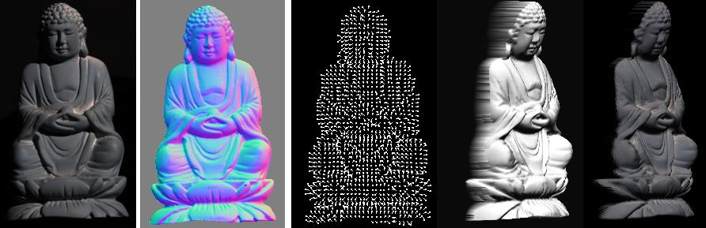
3D MODEL ACQUISITION

Slide 6
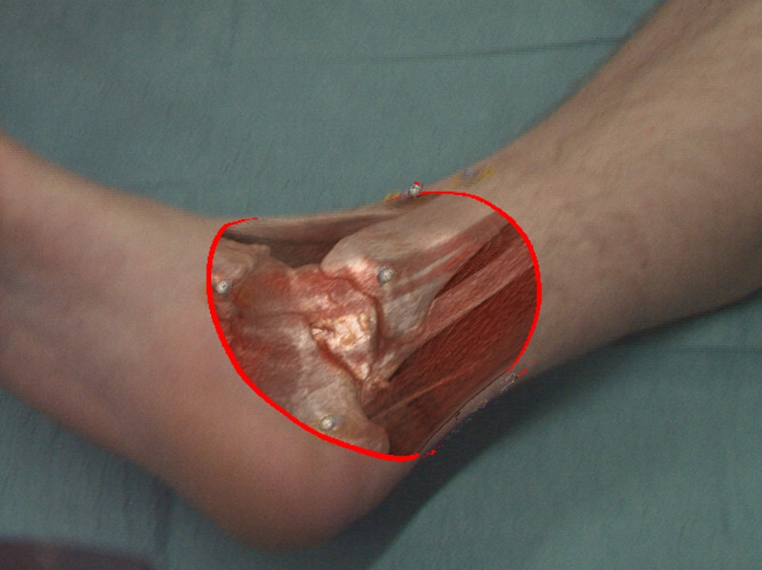
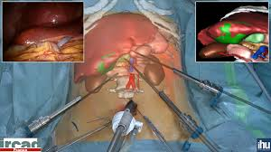
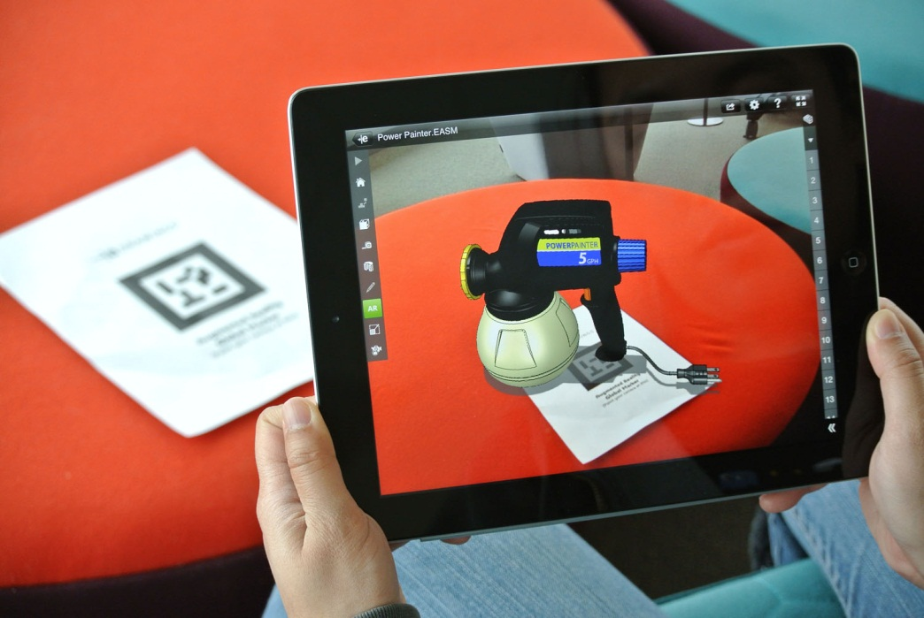
AUGMENTED REALITY

Slide 7
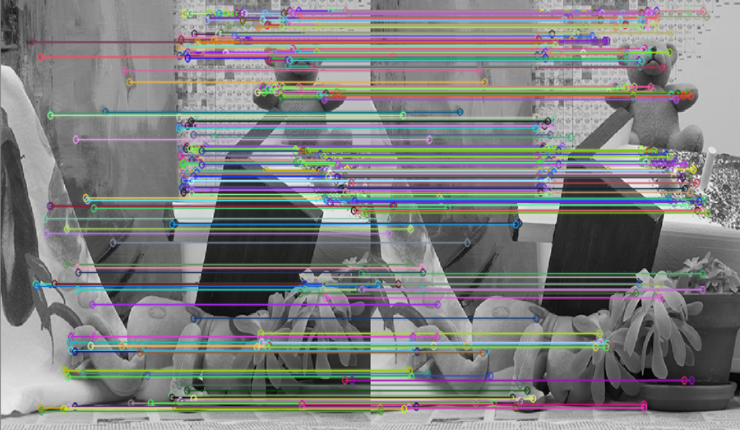
THE ROOT OF IT ALL: CORRESPONDENCE!
Our assignment …

